Slide 1
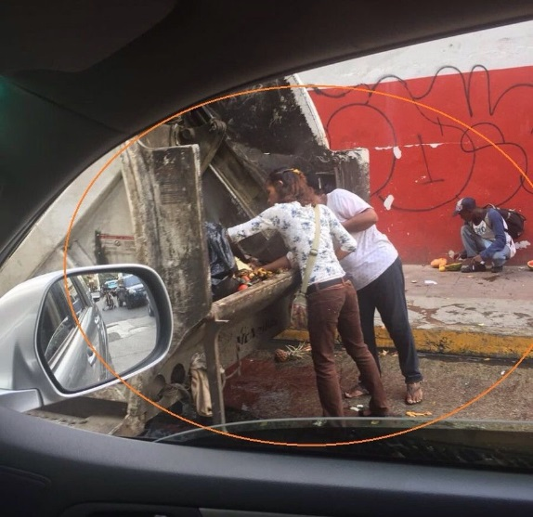
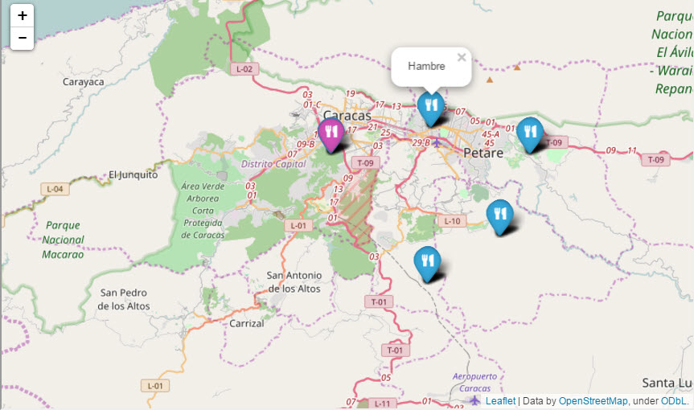
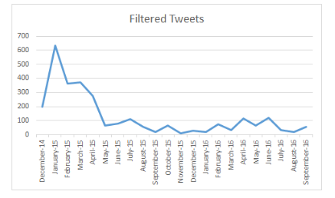
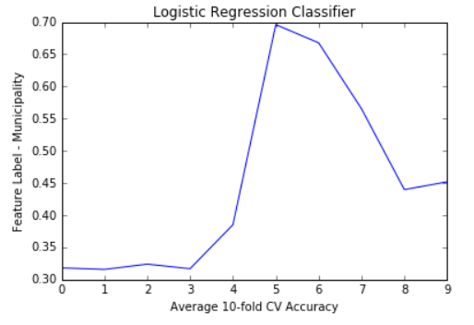
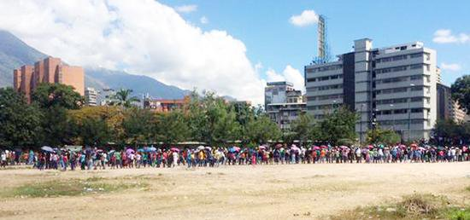
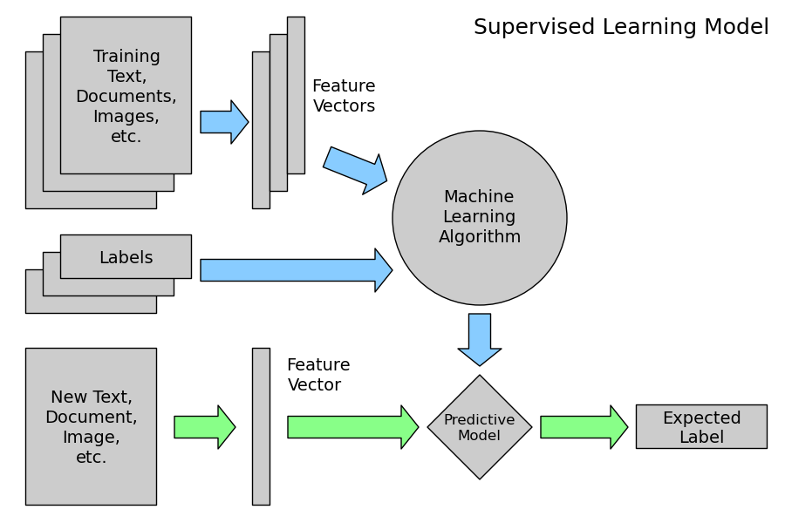
Spatiotemporal Twitter Analysis of the Venezuelan Food Crisis
Laura Kahn 107 S. Indiana Avenue, Bloomington, IN 47405
Introduction
Results
Conclusions
Analysis of microblogs is an interesting form of highly distributed ‘social sensors’ that use Twitter users as crowdsourced field reporters of events.
Food shortages in Venezuela have been prevalent since 2013 and have reached a crisis-level nationwide. The government-controlled media stopped reporting crisis details in January 2015. Social media mining (SMM) plays a critical role in countries like Venezuela.
Out of the approximately 1.32 million Tweets from Caracas during the studied time period, about 35% of them were related to the food shortage crisis, demonstrating the significance of the event to the citizens of Caracas.
The most frequently used words (not included in the five original search terms) were ‘puebl’ (‘pueblo’/people), ‘distribu’ (‘distribución’/distribution), , ‘col’ (‘cola’/line), ‘medicin’ (‘medicina’/medicine), ‘compr’ (‘compra’/buy) and ‘gobiern’ (‘gobierno’/government).
The adjective and noun search terms were two to three times more popular than the hashtags cited in the traditional media outlets across the city of Caracas except in the Libertador municipality. The term “hambre” (hungry) was the most frequently used term, followed by “alimentos” (foods), then “escasez” (shortage). The word “hambre” (hunger) was the most popular in all municipalities except in Libertador.
A temporal analysis was performed on the total number of filtered Tweets by month. The highest number of filtered Tweets in a month occurred in January 2015 with 632. The number of Tweets drops considerably to 66 in May 2015 and then fluctuates between 11 and 122 each month for the remaining 16 months. The drop in Tweets is consistent with how information is diffused as time elapses after the initial start of the event - also known as Immediacy.
The average 10-fold cross validation accuracy for the naïve Bayes classifier is 0.383 (16.7% improvement); it is 0.448 (28.8% improvement) for the Logistic regression classifier and it is 0.422 (24.4% improvement) for the k-nearest neighbor classifier. Since all three of these models perform better than the baseline classifier (0.32), words used in a Tweet in Caracas are signals of their municipality location.
This is a significant finding that Tweet texts can be discovered at the micro / municipality level or used to predict where Tweets might occur in the future.
SMM from this research can be used to help give insight into how citizens express themselves in space and time. Reactions to food shortage events were examined and spatiotemporal tweeting patterns were detected using Twitter hashtags and other related Spanish terms within each of Caracas, Venezuela’s five municipalities from December 2014 to October 2016 using over 37,000 Spanish language Tweets.
The research is significant because it is the first known data mining analysis of the Venezuelan food crisis using machine learning techniques. The research presents a new depth of detail on this crisis by looking at the reactions from a micro/municipality level. All three of these classifiers perform better than the random or baseline classifier, indicating that words in Tweets are signals of a Caracas municipality location.
Social scientists, researchers, policy makers, governments and international aid relief organizations could use the knowledge gained from this data to make data-driven decisions and / or further analysis of the food shortage crisis at a city-wide or municipality level.
Figure 1 – People look through garbage for food – picture from Tweet corpus
Figure 3. Top words in each Caracas municipality
Methods
The Twitter API was used to collect about 37,000 geotagged Spanish language Tweets from each of the five Caracas, Venezuela’s municipalities from December 2014-October 2016. Search terms included “hambre” (hungry), “alimentos” (foods), “escasez” (shortage), “#AnaquelesVaciosenVenezuela” (#EmptyShelvesin Venezuela) and “#VzlaTieneHambre” (#VenezuelaisHungry). Tweets were filtered into a final data set if they had at least 5 likes or 5 favorites.
Natural Language Processing techniques within Python were used to process the text. Supervised Learning Models including a naïve Bayes, logistic regression and k-nearest neighbor classifiers were used to predict whether certain words in the Tweet were particular to a municipality. Changes in total Tweets over time were also observed.
Figure 4. Number of all Caracas Tweets over time
Figure 2. The Supervised Learning Model takes past data and predicts whether a feature will happen in the future.
Figure 5. Logistic Regression classifier accuracy
Figure 6. Hungry Venezuelans cross the border into Columbia in search of food - picture from Tweet corpus
References
Future Work
Andrienko, G., Andrienko, N., Bosch, B., Ertl, T,, Fuchs, G., Jankowski, P., Thom, D. (2013): Discovering Thematic Patterns in Geo-Referenced Tweets through Space-Time Visual Analytics. In: Computers in Science and Engineering, v.15(3), pp.72-82.
Cranshaw, J, Schwartz, R, Hong, J and N. Sadeh. 2012. The livehoods project: Utilizing social media to understand the dynamics of a city. ICWSM’12.
Korkmaz, G., J. Cadena, C. Kuhlman, A. Marathe, A. Vullikanti, N. Ramakrishnan. Combining Heterogeneous Data Sources for Civil Unrest Forecasting. ASONAM’15 Proceedings of the 2015 IEEE/ACM International Conference on Advances in Social Networks Analysis and Mining 2015, pp. 258-265.
Kounadi, O., T. Lampoltshammer, E. Groff, I. Sitko, M. Leitner. Exploring Twitter to Analyze the Public’s Reaction Patterns to Recently Reported Homicides in a London. PLoS ONE, 10(3), e0121848. doi: 10.1371/journal.pone.0121848.
Zhao, L., T. Hua., C. Lu and I. Chen. A Topic-focused Trust Model for Twitter. Computer Communications, October 2015.
There are several opportunities to build upon this research in the future, including an analysis of the pictures extracted from this Twitter corpus. Future research could try to answer if particular search terms are more prevalent in certain locations
Future research could also be done on the adoption of hashtags during an event versus key search terms in South America and Venezuela to see if they differ than the usage in the rest of the world.
Notes:
1

